Slide 1
Digraphs and Relations
youtube.com/StatsLabDublin
Discrete Mathematics

Slide 2
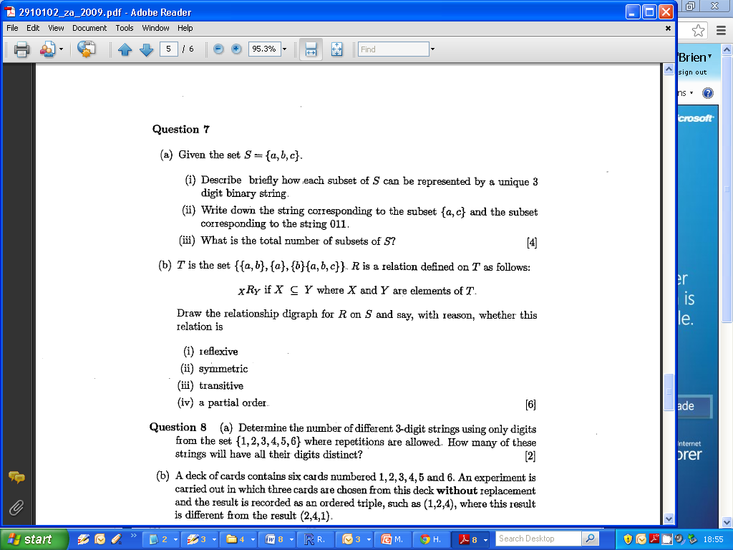
Digraphs and Relations
Draw the relationship digraph of R on S and state
whether or not R is
Reflexive,
Symmetric,
Transitive.

